Slide 1

OFFENSIVE LANGUAGE DETECTION
INT 391-INTERNSHIP 3
FINAL REVIEW
BOBIN J RAJ (E5221017)
INTERNAL GUIDE : BALAJI PRASATH,SRET
EXTERNAL GUIDE : DR.BALASUBRAMANIAN P,IIIT KOTTAYAM
1

Slide 2
INTRODUCTION
Nowadays we are well aware of the fact that if social media platforms are not handled carefully then they can create chaos in the world.
One of the problems faced on these platforms are usage of Hate Speech and Offensive Language. Usage of such Language often results in fights, crimes or sometimes riots at worst.
So, Detection of such language is essential and as humans cannot monitor such large volumes of data, we can take help of AI and detect the use of such language and prevent users from using such languages.
2

Slide 3
METHODOLOGY
DATASET
PREPROCESSING
DATA ENCODING
DL CLASSIFIER/KERAS MODEL
OUTPUT
3

Slide 4
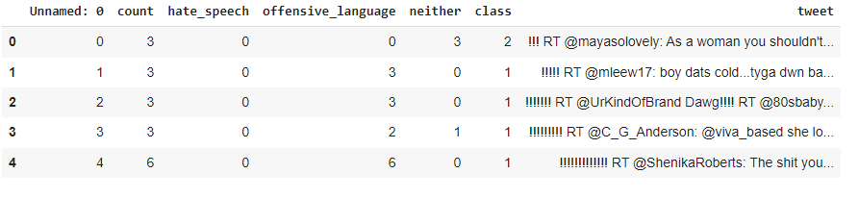
DATASET
TWITTER.CSV
4

Slide 5
PREPROCESSING
Ratio to hate speech:offensive records:ok are 1.0 : 13.4 : 2.9
Comparing to other records there are too many records are in offensive category. If we don't trim this ratio it will cause our predictive model to have a tendency to predict ok or hate speech tweets as offensive.I will remove 1/2 of them that will trim it down to 9595.Total records will be trimmed down to 15185.
Used Tokenizer for converting an sequence of data into smaller parts.
5

Slide 6
DATA ENCODING
Used numpy to create feature vectors of raw data ie. Text
Used one hot encoder using keras.util.to_categorical this coverts class labels into binary class matrix
6

Slide 7
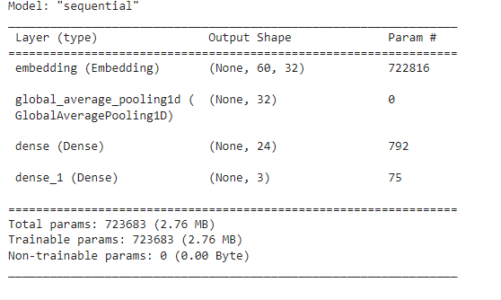
MODEL 1
SIMPLE NEURAL NETWORK
7

Slide 8
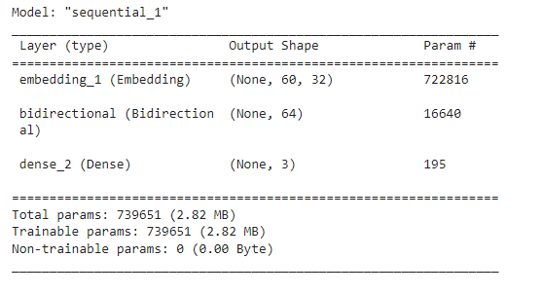
MODEL 2
RECURRENT NEURAL NETWORK
8

Slide 9
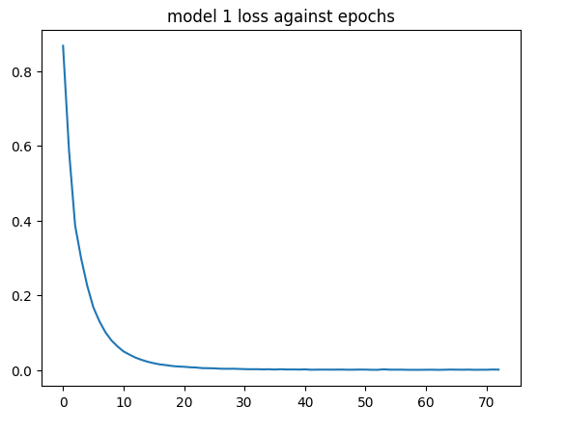
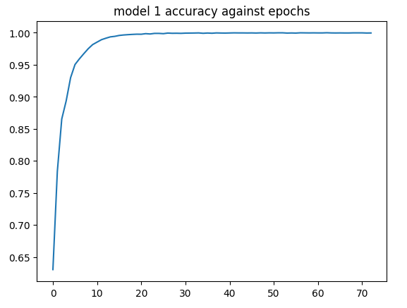
RESULTS
MODEL 1
9

Slide 10
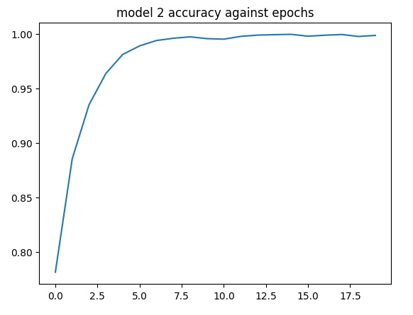
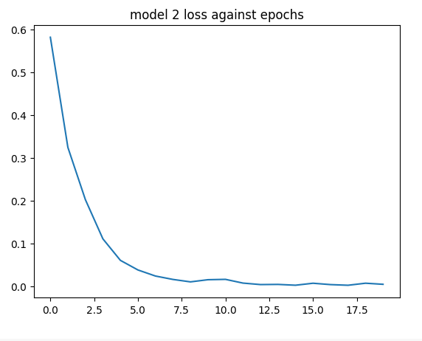
RESULTS
MODEL 2
10

Slide 11
RESULTS
FOR MODEL 1 THE ACCURACY IS 82%
FOR MODEL 2 THE ACCURACY IS 85%
SO WE TAKE 2ND MODEL FOR TESTING AND SAVE THIS MODEL
11

Slide 12
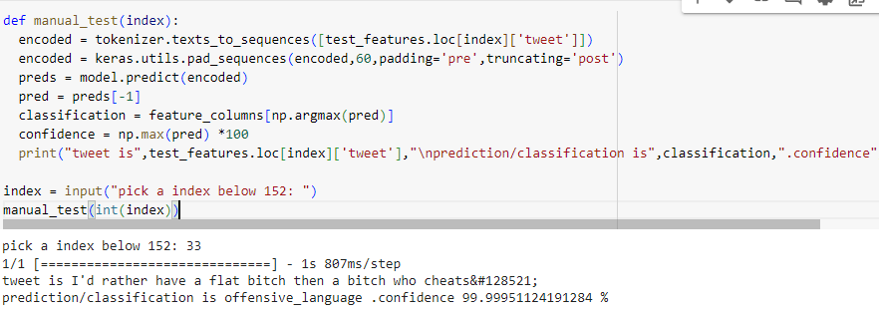
TESTING
12

Slide 13


REAL TIME PREDICTION
INPUT : I don't agree with you. I think your ideas dumb
OUTPUT:
INPUT : I LOVE you. I WANNA LOVE YOU
OUTPUT:
13

Slide 14
REFERENCE
1. Offensive Language Detection Using Multi-level Classification
https://link.springer.com/chapter/10.1007/978-3-642-13059-5_5
2. Teneo Offensive Language Detector NL Analyzer
https://developers.teneo.ai/documentation/7.5.0/reference/pre-built-knowledge/teneo-offensive-language
3. Offensive Language Detection Using Multi-level Classification
https://www.researchgate.net/publication/221442147_Offensive_Language_Detection_Using_Multi-level_Classification
4. Towards offensive language detection and reduction
https://dl.acm.org/doi/abs/10.1145/3463274.3463805
5. Enhancing Offensive Language Detection
https://spj.science.org/doi/10.34133/research.0189
14

Slide 15
CONCLUSION
Offensive language detection is a critical task in various applications, including social media moderation, chatbots, and content filtering.
By leveraging an RNN (Recurrent Neural Network) model, you’ve achieved promising results in real-time scenarios.
The bidirectional nature of the RNN allows it to capture context effectively, making it suitable for sequential data like text.
15

Slide 16


